Slide 1
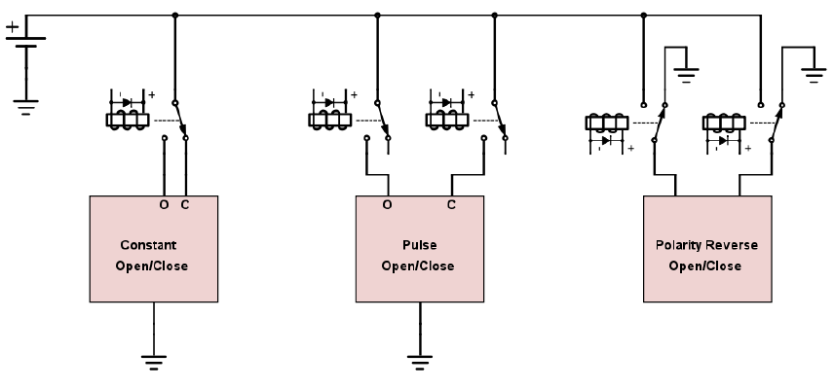
Launch Relay System - Design
Wireless fill and launch control
N₂O fill/vent, O₂ fill, quick disconnect, igniter
Wired data connection to rocket
Modularity and future SRT use
Solenoid compatibility
Hold o/c, pulse o/c, 12 VDC, 24 VDC
1 or 2 car battery operation
3 extra channels (easily expandable)
Safety
Separate computer power source
Pushbutton 20 mA igniter continuity test
Primary arming key switch and igniter disable switch
Remote control solenoid and igniter arming (with buzzer)
3 Types of Solenoids
Launch Control
Electronics and Payload

Slide 2
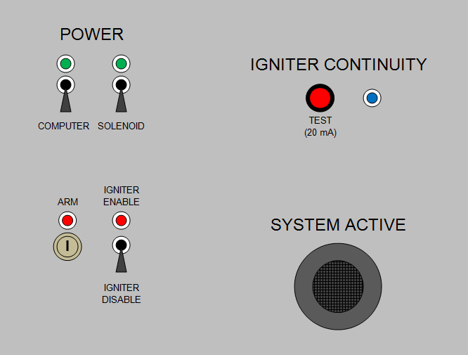
Launch Relay System – Key Components
Container and interface
ABS hinged box
15" L x 11" W x 6” H
Steel mounting plate
Stainless DIN 3 rail
12x 20 A receptacles for solenoids
4x car battery clamps
Switching and control
Arduino Mega 2560 R3
16x N-channel MOSFETs
11x SPDT 16 A relays
2x arming relays
100 A igniter relay
Launch Box Interface Panel
Launch Control
Electronics and Payload

Slide 3
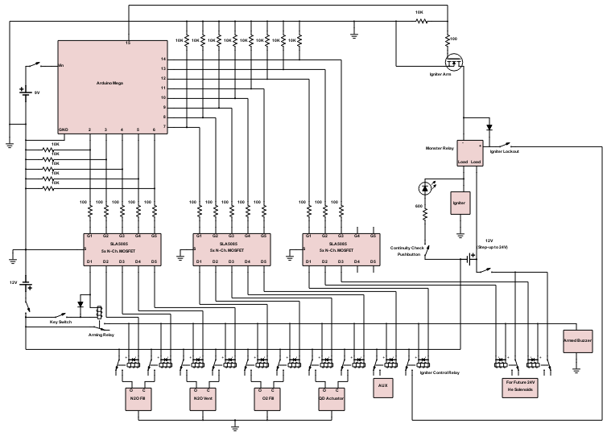
Launch Relay System - Diagram
Arduino Mega
Igniter Arming
MOSFET (-)
9V Battery
(Arduino ~5 hr
supply)
Igniter Relay and
Lockout Switch
5 pack N-Ch
MOSFETs
Continuity Test
12 V Car
Battery
24 V Step-Up
(Car Battery)
Arming Key
Switch and Relay
Warning
Buzzer
16 A Solenoid Relays
(built in flyback diode
and test LED)
24 V Relay
Section
Launch Control
Electronics and Payload

Slide 4
Launch Relay System – Sequence
Connect batteries
Power on computer
Power on solenoids
Test igniter continuity
Enable igniter circuit
Arm with the key switch
Move personnel to safe distance
Wirelessly activate arming relay (buzzer sounds)
Oxidizer fill sequence
Wirelessly arm igniter relay
Ignition
Disarm in reverse
2.
3.
4.
6.
8.
5.
Launch Box Interface Panel
Launch Control
Electronics and Payload

